Slide 2
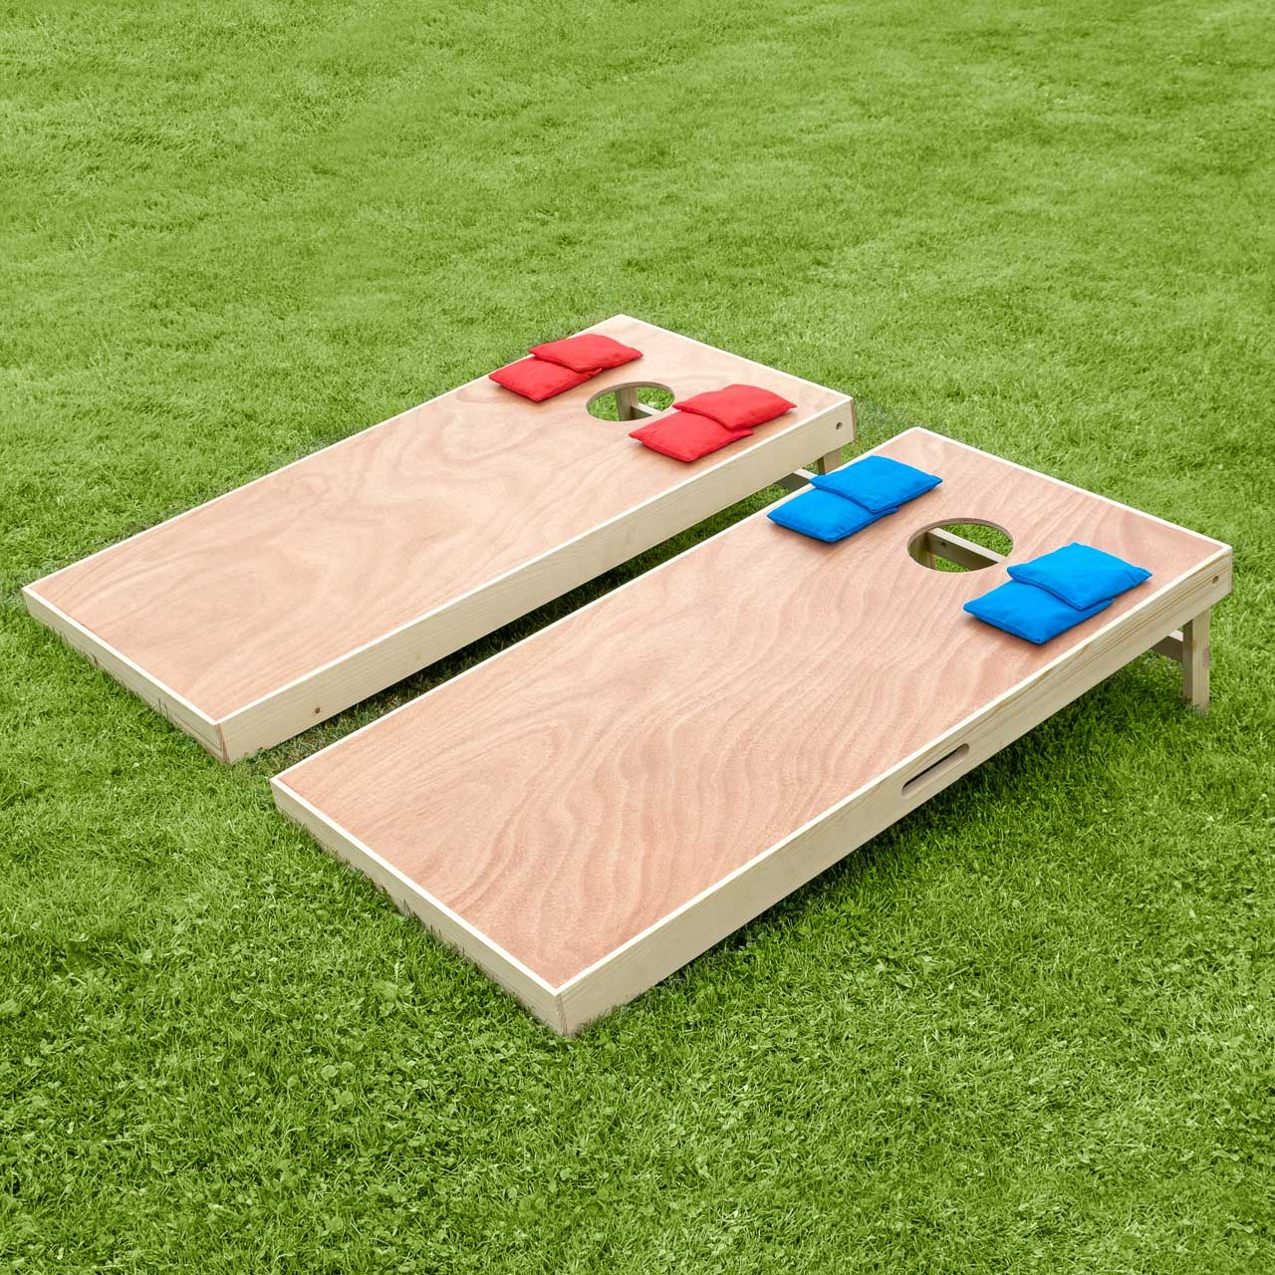
The Cornhole Sermon

Slide 3
What does cornhole have to do with Jesus?
Ecclesiastes 7:15-18

Slide 4
Don’t underthrow it

Slide 5
Romans 6:20-21
For when you were slaves of sin, you were free with regard to righteousness. So what fruit was produced then from the things you are now ashamed of? The outcome of those things is death.

Slide 6
Galatians 5:19-21
2 Timothy 3:1-5

Slide 7
James 1:13-15
No one undergoing a trial should say, “I am being tempted by God,” since God is not tempted by evil, and he himself doesn’t tempt anyone. But each person is tempted when he is drawn away and enticed by his own evil desire. Then after desire has conceived, it gives birth to sin, and when sin is fully grown, it gives birth to death.

Slide 8
Don’t overthrow it

Slide 9
Ephesians 2:8-9
For you are saved by grace through faith, and this is not from yourselves; it is God’s gift— not from works, so that no one can boast.

Slide 10
James 2:10
For whoever keeps the entire law, and yet stumbles at one point, is guilty of breaking it all.

Slide 11
Romans 3:23-24
For all have sinned and fall short of the glory of God; they are justified freely by his grace through the redemption that is in Christ Jesus.

Slide 12
Focus on the center

Slide 13
Hebrews 12:1-3
Therefore, since we also have such a large cloud of witnesses surrounding us, let us lay aside every hindrance and the sin that so easily ensnares us. Let us run with endurance the race that lies before us, keeping our eyes on Jesus, the pioneer and perfecter of our faith. For the joy that lay before him, he endured the cross, despising the shame, and sat down at the right hand of the throne of God.

