Slide 2
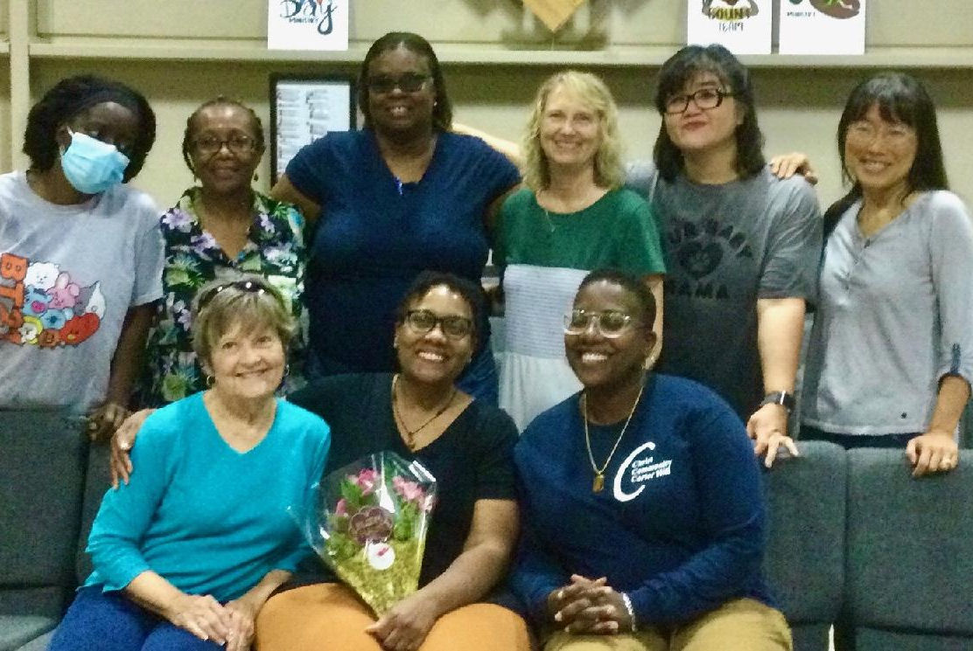
Welcome to the Kingdom, Nicole!

Slide 3
He is…calling us higher!

Slide 4
Mark 9:14-29
CALLED TO A HIGHER FAITH

Slide 5
Colossians 3:1-4
CALLED TO A HIGHER HOPE

Slide 6
JOHN 13:34-35
CALLED TO A HIGHER LOVE

Slide 7
“TUERCELE EL CUELLO AL CISNE”

