Slide 1
HE IS OUR HEAVENLY FATHER (PART II)

Slide 2
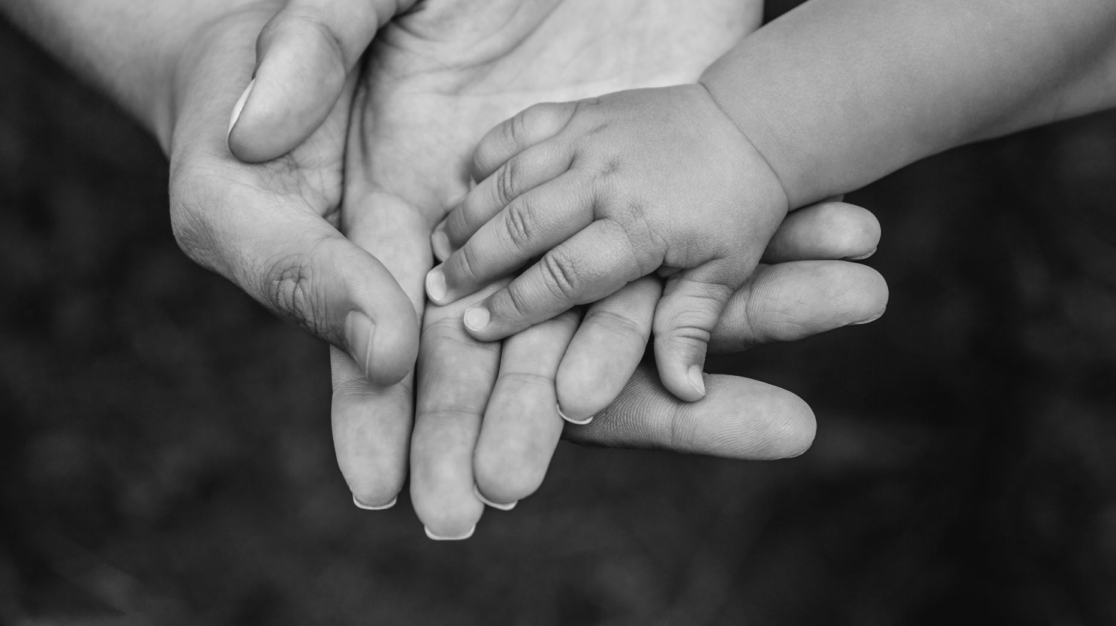
Matthew 7:7-12
Notes:
Our Heavenly Father is tender (but firm)

Slide 3
Mark 14:36
And he said, “Abba, Father! All things are possible for you. Take this cup away from me. Nevertheless, not what I will, but what you will.”

Slide 4
For you did not receive a spirit of slavery to fall back into fear. Instead, you received the Spirit of adoption, by whom we cry out, “Abba, Father!” - Romans 8:15
And because you are sons, God sent the Spirit of his Son into our hearts, crying, “Abba, Father!” - Galatians 4:6

Slide 5
Matthew 7:13-23
Notes:
Our Heavenly Father is tough (but fair)

Slide 6
Hebrews 12:3-11

