Slide 2
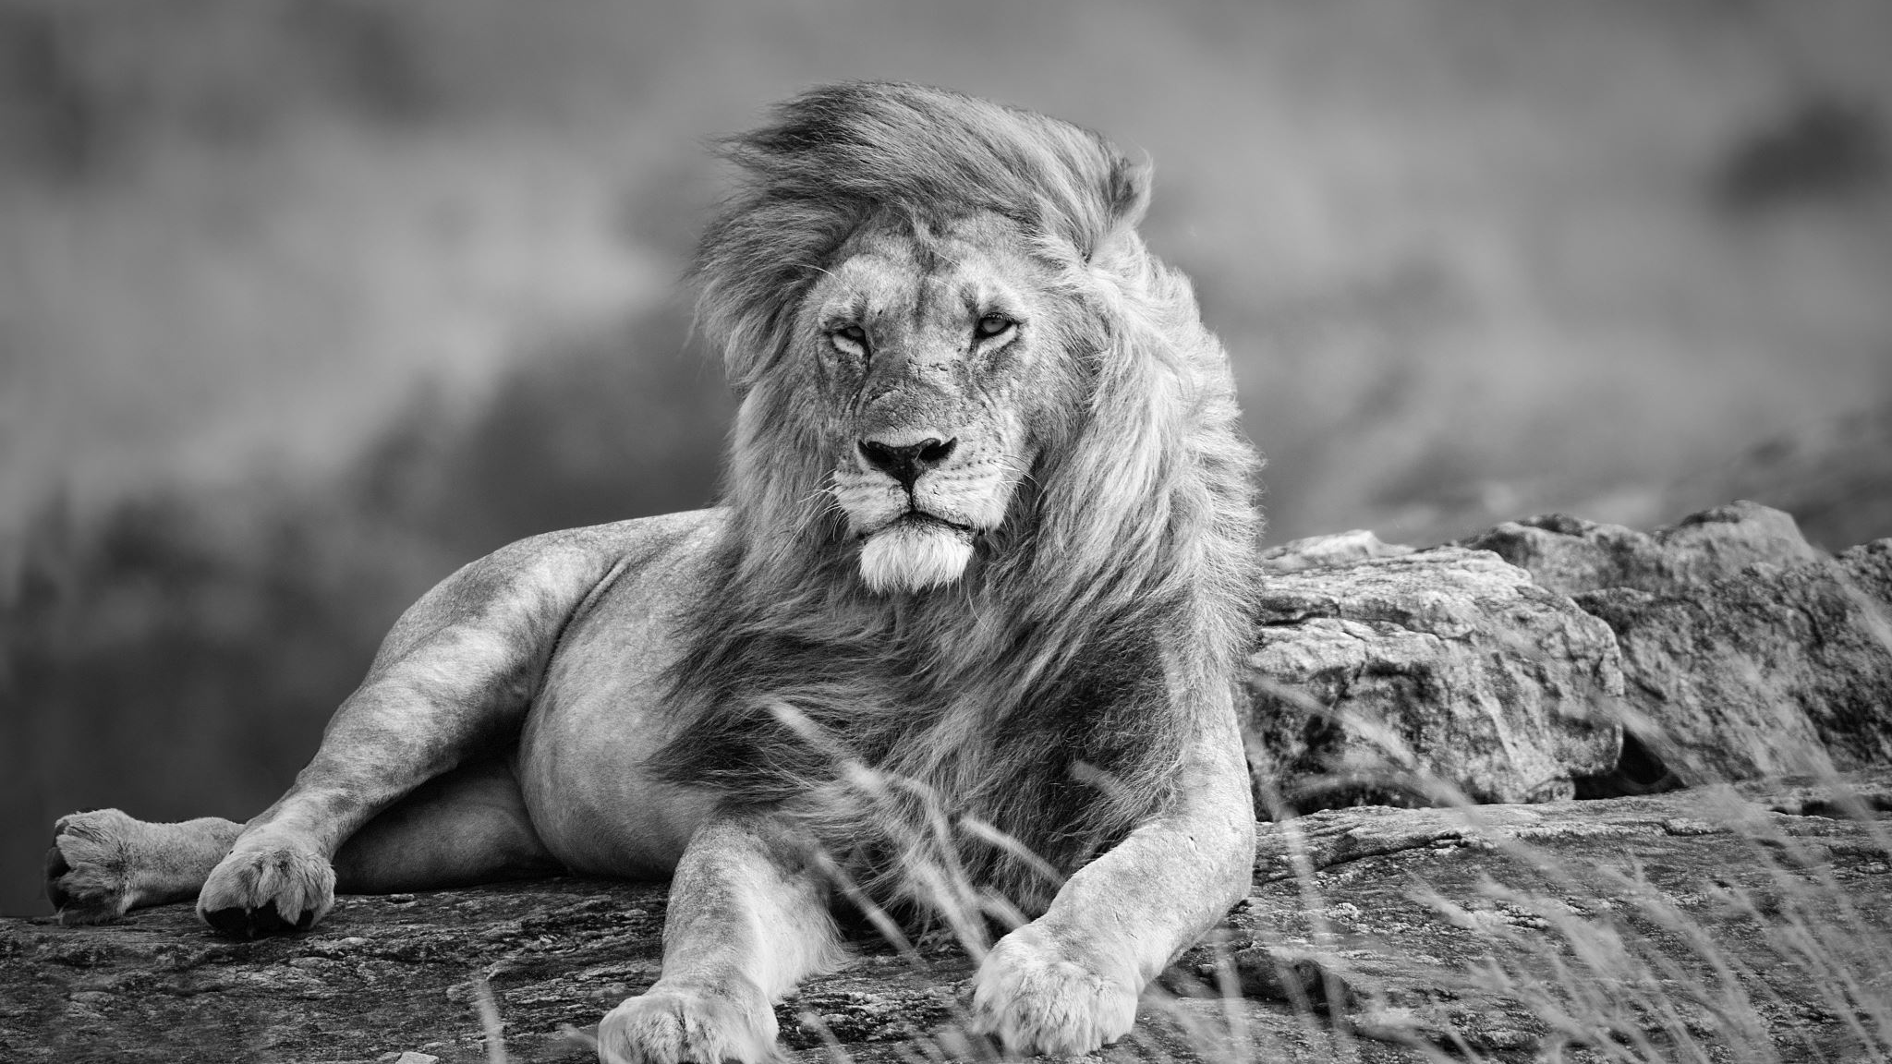
He is a “storyteller”:
The story of a king

Slide 3
The king’s story
Luke 19:11-27

Slide 4
“We don’t want this man to rule over us.”
Luke 14:25-35

Slide 5
Luke 9:23-24
Then he said to them all, “If anyone wants to follow after me, let him deny himself, take up his cross daily, and follow me. ²⁴ For whoever wants to save his life will lose it, but whoever loses his life because of me will save it.

Slide 6
A quote by Matthew Bates:

