Slide 1
Life Under God
Part 2

Slide 2
Life Under God The Good

Slide 3
Hear, Israel, and be careful to obey so that it may go well with you and that you may increase greatly in a land flowing with milk and honey, just as the Lord, the God of your ancestors, promised you.
Hear, O Israel: The Lord our God, the Lord is one. Love the Lord your God with all your heart and with all your soul and with all your strength.

Slide 4
These commandments that I give you today are to be on your hearts. Impress them on your children. Talk about them when you sit at home and when you walk along the road, when you lie down and when you get up. Tie them as symbols on your hands and bind them on your foreheads. Write them on the doorframes of your houses and on your gates.
-- Deuteronomy 6:3-9

Slide 5
We actually ARE under God…and should be very happy about that!
Creator ➔ created
Father ➔ children
Provider ➔ providees (not really a word, but you get the idea)
Protector ➔ protected
Shepherd ➔ sheep
Teacher ➔ students
King ➔ subjects
Loves ➔ loved

Slide 6
HE IS…
Then the Lord came down in the cloud and stood there with him and proclaimed his name, the Lord. And he passed in front of Moses, proclaiming, “The Lord, the Lord, the compassionate and gracious God, slow to anger, abounding in love and faithfulness, maintaining love to thousands, and forgiving wickedness, rebellion and sin” -- Ex 34:5-7a

Slide 7
HE IS…
“The God who made the world and everything in it is the Lord of heaven and earth and does not live in temples built by human hands. And he is not served by human hands, as if he needed anything. Rather, he himself gives everyone life and breath and everything else.

Slide 8
HE IS…
From one man he made all the nations, that they should inhabit the whole earth; and he determined the times set for them and the exact places where they should live. God did this so that they would seek him and perhaps reach out for him and find him, though he is not far from any one of us. ‘For in him we live and move and have our being.’ – Acts 17:24-28a

Slide 9
Obedience/submission to God is highly honored…by God
Enoch: Enoch walked faithfully with God; then he was no more, because God took him away –- Gen 5:24
Noah: Noah did everything just as God commanded him –- Gen 6:22
Abraham: and through your offspring all nations on earth will be blessed, because you have obeyed me –- Gen 22:18

Slide 10
Obedience/submission to God is highly honored…by God
Israel: You have declared this day that the Lord is your God and that you will walk in obedience to him, that you will keep his decrees, commands and laws—that you will listen to him. And the Lord has declared this day that you are his people, his treasured possession as he promised, and that you are to keep all his commands. He has declared that he will set you in praise, fame and honor high above all the nations he has made and that you will be a people holy to the Lord your God, as he promised -- Deu 26:17-19

Slide 11
Jesus showed us EXACTLY how we should relate to and with God
Jesus gave them this answer: “Very truly I tell you, the Son can do nothing by himself; he can do only what he sees his Father doing, because whatever the Father does the Son also does. For the Father loves the Son and shows him all he does. Yes, and he will show him even greater works than these, so that you will be amazed. For just as the Father raises the dead and gives them life, even so the Son gives life to whom he is pleased to give it. – Jn 5:19-21

Slide 12
Jesus showed us EXACTLY how we should relate to and with God
So Jesus said, “When you have lifted up the Son of Man, then you will know that I am he and that I do nothing on my own but speak just what the Father has taught me. The one who sent me is with me; he has not left me alone, for I always do what pleases him.” – Jn 8:28-29

Slide 13
Jesus showed us EXACTLY how we should relate to and with God
During the days of Jesus’ life on earth, he offered up prayers and petitions with fervent cries and tears to the one who could save him from death, and he was heard because of his reverent submission. ⁸ Son though he was, he learned obedience from what he suffered ⁹ and, once made perfect, he became the source of eternal salvation for all who obey him – Heb 5:7-9

Slide 14
I find it helpful to consider this as you read the “WITH” book: Skye is pulling the aspects of the Under God posture that are good and right into or under the umbrella of the With God posture.
When we are truly WITH God, then we will also willingly submit to him out of reverence & relationship.
We will eagerly accept, and be thankful for his fathering, protection, direction and even his correction and YIKES! ...firm rebukes...because we NEED them…and we TRUST HIM!
If we aren't truly striving to be WITH God, then being Under God is a useless, futile and downright destructive way to live.

Slide 15
Life Under God The Bad & The Ugly

Slide 16
Life under God is not good or healthy when we…
Try to appease God or have a transactional relationship with him
God does bless obedience, but…
Try to control or oppress others in order to procure blessings or prevent punishment/calamity
Are hypocritical – concerned about the appearance of piety rather than humbly walking with God
Whitewashed tombs, Cleaning the outside of the cup
Try to use God to get something else that we want
What is my Treasure?

Slide 17
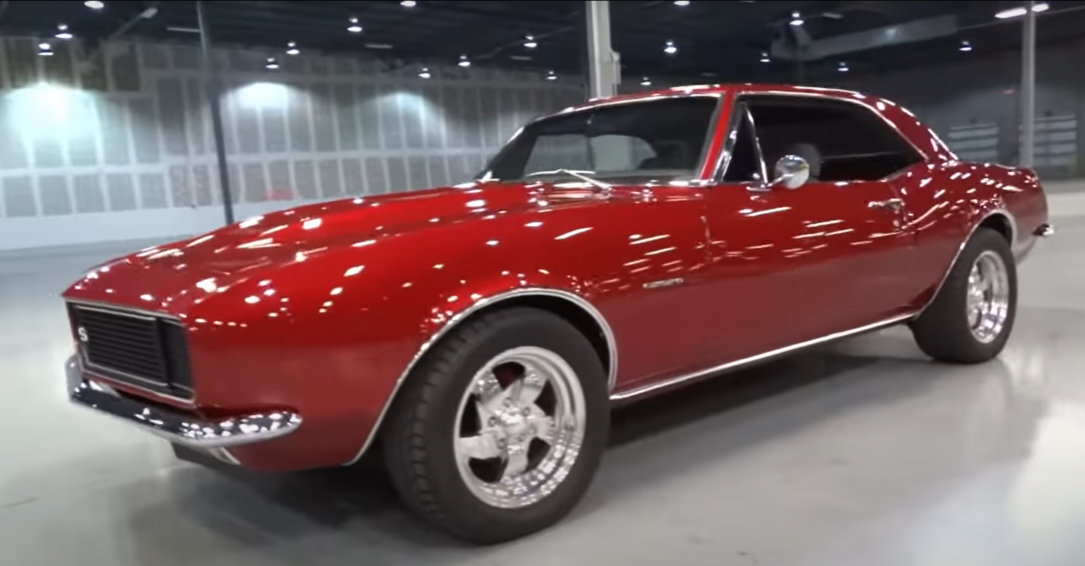

Slide 18
