Slide 2
PRAYER WAS HIS CORNERSTONE

Slide 3
Baptism (Luke 3:21-22)
When all the people were baptized, Jesus also was baptized. As he was praying, heaven opened, and the Holy Spirit descended on him in a physical appearance like a dove. And a voice came from heaven: “You are my beloved Son; with you I am well-pleased.”

Slide 4
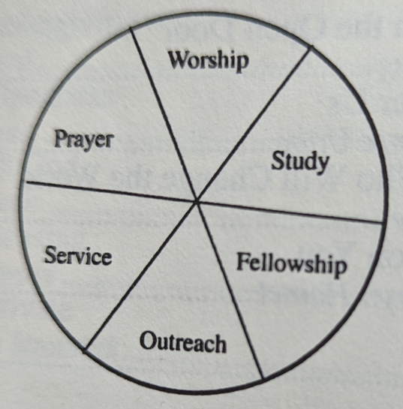

Slide 5
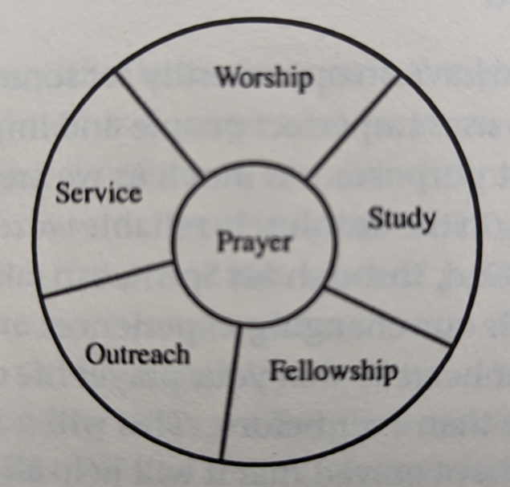
When it was day, he went out and made his way to a deserted place. But the crowds were searching for him. They came to him and tried to keep him from leaving them…Yet he often withdrew to deserted places and prayed. - Luke 4:42, Luke 5:16

Slide 6
“So, we don’t pray to check off a box or do what every ‘good Christian’ does; we pray because it is in the fabric of our spiritual DNA.”
- Ashlenn Von Wiegand

Slide 7
Garden of Gethsemane (Luke 22:39-46)
Then he withdrew from them about a stone’s throw, knelt down, and began to pray, “Father, if you are willing, take this cup away from me—nevertheless, not my will, but yours, be done.”

Slide 8
Garden of Gethsemane (Luke 22:39-46)
Then an angel from heaven appeared to him, strengthening him. Being in anguish, he prayed more fervently, and his sweat became like drops of blood falling to the ground.

Slide 9
“During his earthly life, he offered prayers and appeals with loud cries and tears to the one who was able to save him from death, and he was heard because of his reverence.”
- Hebrews 5:7

Slide 10
Crucifixion and Death (Luke 23:34, 46)
Then Jesus said, “Father, forgive them, because they do not know what they are doing.” And they divided his clothes and cast lots…And Jesus called out with a loud voice, “Father, into your hands I entrust my spirit.” Saying this, he breathed his last.

Slide 11
“Who is the one who condemns? Christ Jesus is the one who died, but even more, has been raised; he also is at the right hand of God and intercedes for us.” – Romans 8:34

Slide 12
→

