Slide 2
PRAYER WAS HIS CORNERSTONE

Slide 3
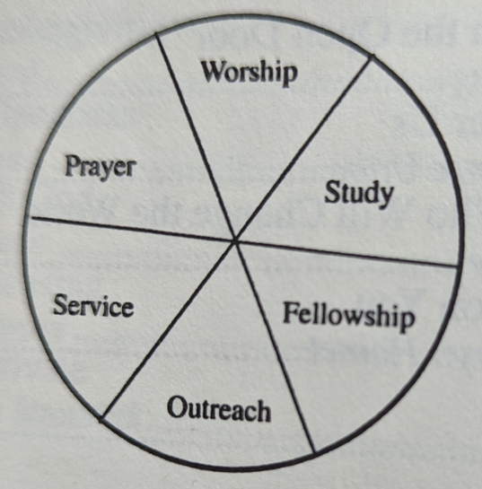
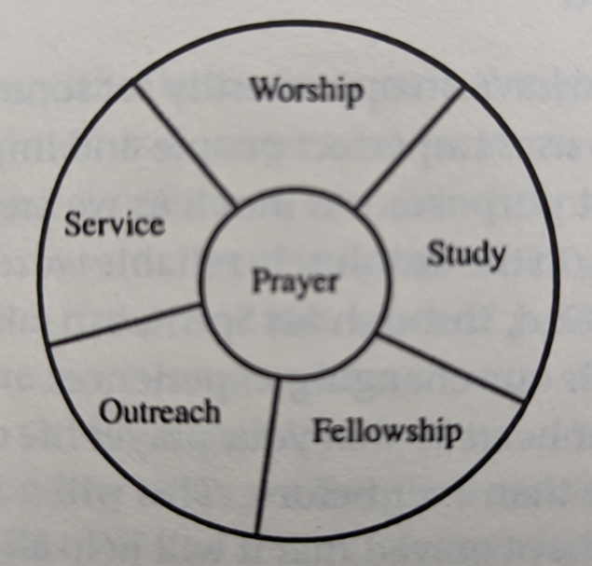
→

Slide 4
PRAYER WAS THEIR CORNERSTONE

Slide 5
Acts 1:9-11
After he had said this, he was taken up as they were watching, and a cloud took him out of their sight. While he was going, they were gazing into heaven, and suddenly two men in white clothes stood by them. They said, “Men of Galilee, why do you stand looking up into heaven? This same Jesus, who has been taken from you into heaven, will come in the same way that you have seen him going into heaven.”

Slide 6
Acts 1:12-14
Then they returned to Jerusalem from the Mount of Olives, which is near Jerusalem—a Sabbath day’s journey away. When they arrived, they went to the room upstairs where they were staying: Peter, John, James, Andrew, Philip, Thomas, Bartholomew, Matthew, James the son of Alphaeus, Simon the Zealot, and Judas the son of James. They all were continually united in prayer, along with the women, including Mary the mother of Jesus, and his brothers.

Slide 7
PRAYER and decisions

Slide 8
Acts 1:23-26
So they proposed two: Joseph, called Barsabbas, who was also known as Justus, and Matthias. Then they prayed, “You, Lord, know everyone’s hearts; show which of these two you have chosen to take the place in this apostolic ministry that Judas left to go where he belongs.” Then they cast lots for them, and the lot fell to Matthias and he was added to the eleven apostles.

Slide 9
Acts 6:5-6
But we will devote ourselves to prayer and to the ministry of the word.”This proposal pleased the whole company. So they chose Stephen, a man full of faith and the Holy Spirit, and Philip, Prochorus, Nicanor, Timon, Parmenas, and Nicolaus, a convert from Antioch. They had them stand before the apostles, who prayed and laid their hands on them.

Slide 10
Acts 13:1-3
Now in the church at Antioch there were prophets and teachers: Barnabas, Simeon who was called Niger, Lucius of Cyrene, Manaen, a close friend of Herod the tetrarch, and Saul. As they were worshiping the Lord and fasting, the Holy Spirit said, “Set apart for me Barnabas and Saul for the work to which I have called them.” Then after they had fasted, prayed, and laid hands on them, they sent them off.

Slide 11
PRAYER and difficulties

Slide 12
Acts 3:23-24,31
After they were released, they went to their own people and reported everything the chief priests and the elders had said to them. ²⁴ When they heard this, they raised their voices together to God and said, “Master, you are the one who made the heaven, the earth, and the sea, and everything in them…When they had prayed, the place where they were assembled was shaken, and they were all filled with the Holy Spirit and began to speak the word of God boldly.

Slide 13
Acts 12:1-5, 12
About that time King Herod violently attacked some who belonged to the church, and he executed James, John’s brother, with the sword. When he saw that it pleased the Jews, he proceeded to arrest Peter too, during the Festival of Unleavened Bread. After the arrest, he put him in prison and assigned four squads of four soldiers each to guard him, intending to bring him out to the people after the Passover. So Peter was kept in prison, but the church was praying fervently to God for him…As soon as he realized this, he went to the house of Mary, the mother of John who was called Mark, where many had assembled and were praying.

Slide 14
Following Jesus in prayer
While they were stoning Stephen, he called out, “Lord Jesus, receive my spirit!” He knelt down and cried out with a loud voice, “Lord, do not hold this sin against them!” And after saying this, he fell asleep. -Acts 7:59-60
Then Jesus said, “Father, forgive them, because they do not know what they are doing.” And they divided his clothes and cast lots…And Jesus called out with a loud voice, “Father, into your hands I entrust my spirit.” Saying this, he breathed his last. – Luke 23:34,46

Slide 15
Acts 2:42
They devoted themselves to the apostles’ teaching, to the fellowship, to the breaking of bread, and to prayer.

