Slide 1
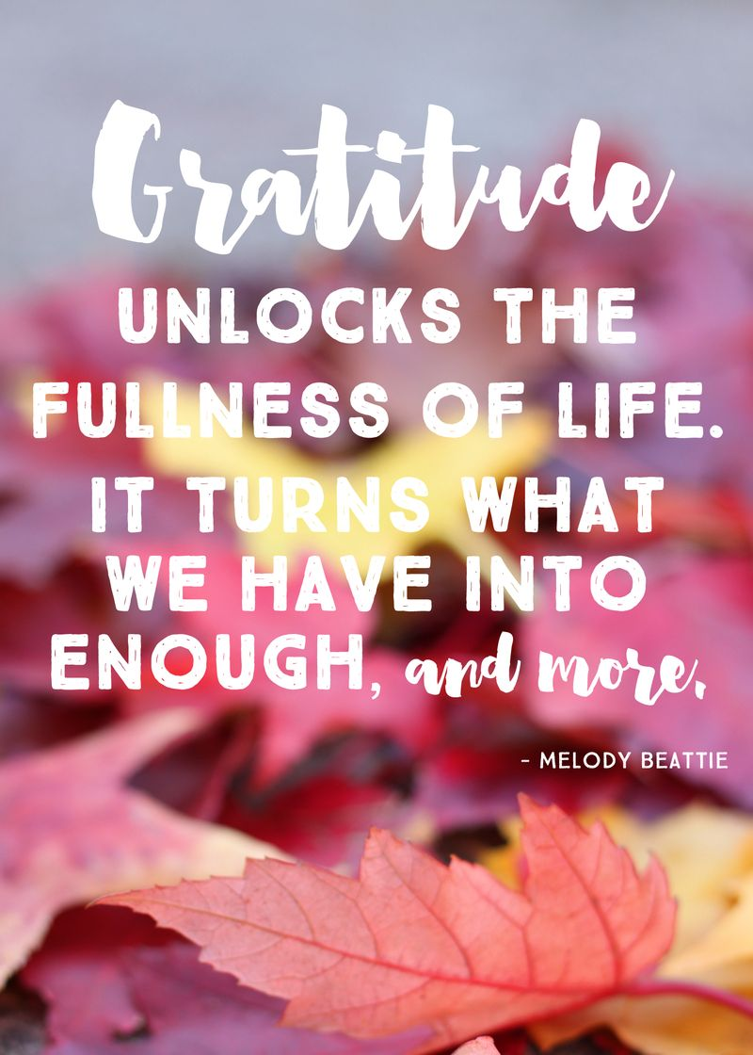
Gratitude for Cornerstone
November 5, 2023

Slide 2
Today’s Sermon: Two parts
Short review and reminder of ROTH principles from last summer
“Escaping the Matrix”

Slide 3
“The story of your life is the story of the long, brutal assault upon your heart by the one who knows what you could be and fears you.” John Eldredge Waking the Dead

Slide 4
RESTORATION OF THE HEART

Slide 5
FREEDOM = RESTORATION OF THE HEART
How do we serve God wholeheartedly with a heart that has been broken in pieces?
Jesus came to heal the brokenhearted…Luke 4:18
Jesus is the same…Heb 13:8
Jesus still wants in…Rev 3:20

Slide 6
ROTH Learning Nuggets P1
Deepening your conviction in the trancendent importance of the healing of your broken heart
Understanding the difference between the restoration of your heart and the salvation of your soul
Understanding God’s view of your good heart
Capturing the vision that God has for your good heart
Knowing that your broken places are NOT God’s will, but your opportunity to glorify God

Slide 7
ROTH Learning Nuggets P2
Knowing that to have the COURAGE to go back into your story and go DEEPER into your story by giving a VOICE to the wounds of your broken heart.
Understanding that your enemy uses your wounds and brokenness to get you STUCK IN SIN
Knowing that “white knuckling” against sin is the enemy’s plot for you to focus on the symptom and not the real problem or the cure

Slide 8
God made your heart to heal, not stay broken

Slide 10
God didn’t make your heart to be damaged forever! (research fact: neuroplasticity)

Slide 11
Been through a lot? Too much? Weary? Have you quit? Quit dreaming? Changing?
Movies INSPIRE us when, against all odds somebody doesn’t QUIT…..Rudy, Hoosiers, Braveheart, Erin Brokavich, Gladiator, Jason Bourne, Jesus
Have you given up on your heart, on changing, on becoming like Christ?
Have “besetting sins”, deep/tough character changes rendered you STUCK?
Are you STUCK IN THE MATRIX?

Slide 12
OUR CHOICES BRING FREEDOM…
Am I making great choices?
Do I understand the importance of my choices?
Do I take full responsibility for my choices?
Do I blame others for my choices?

Slide 13
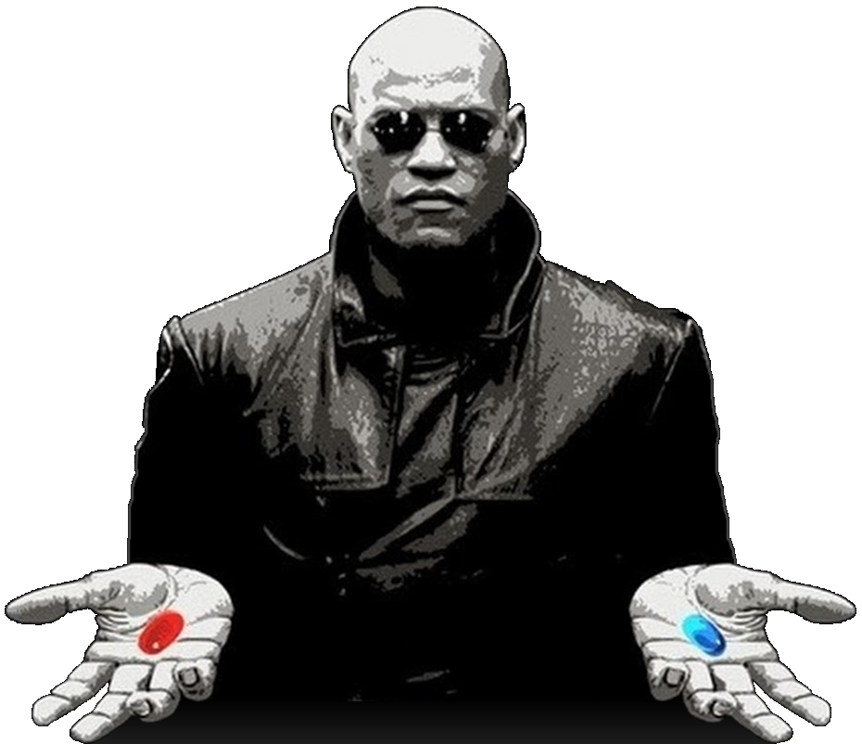
CHOICE

Slide 14
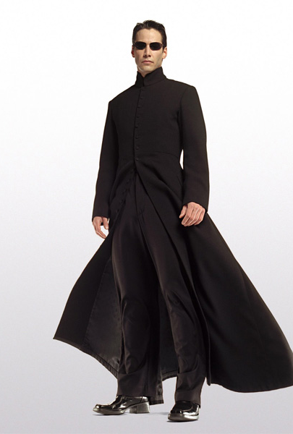
Escaping the Matrix
Are you in the matrix?
Do you want to get out?

Slide 15
CHOICE….MEANS FREEDOM
This Photo by Unknown Author is licensed under CC BY-SA

Slide 16
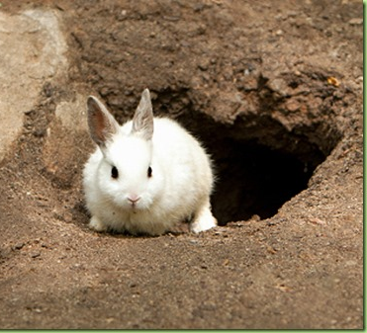
HAVE YOU GONE …

Slide 17
I. The matrix of western thought a. Performance trap b. Individualism c. Materialism

Slide 18
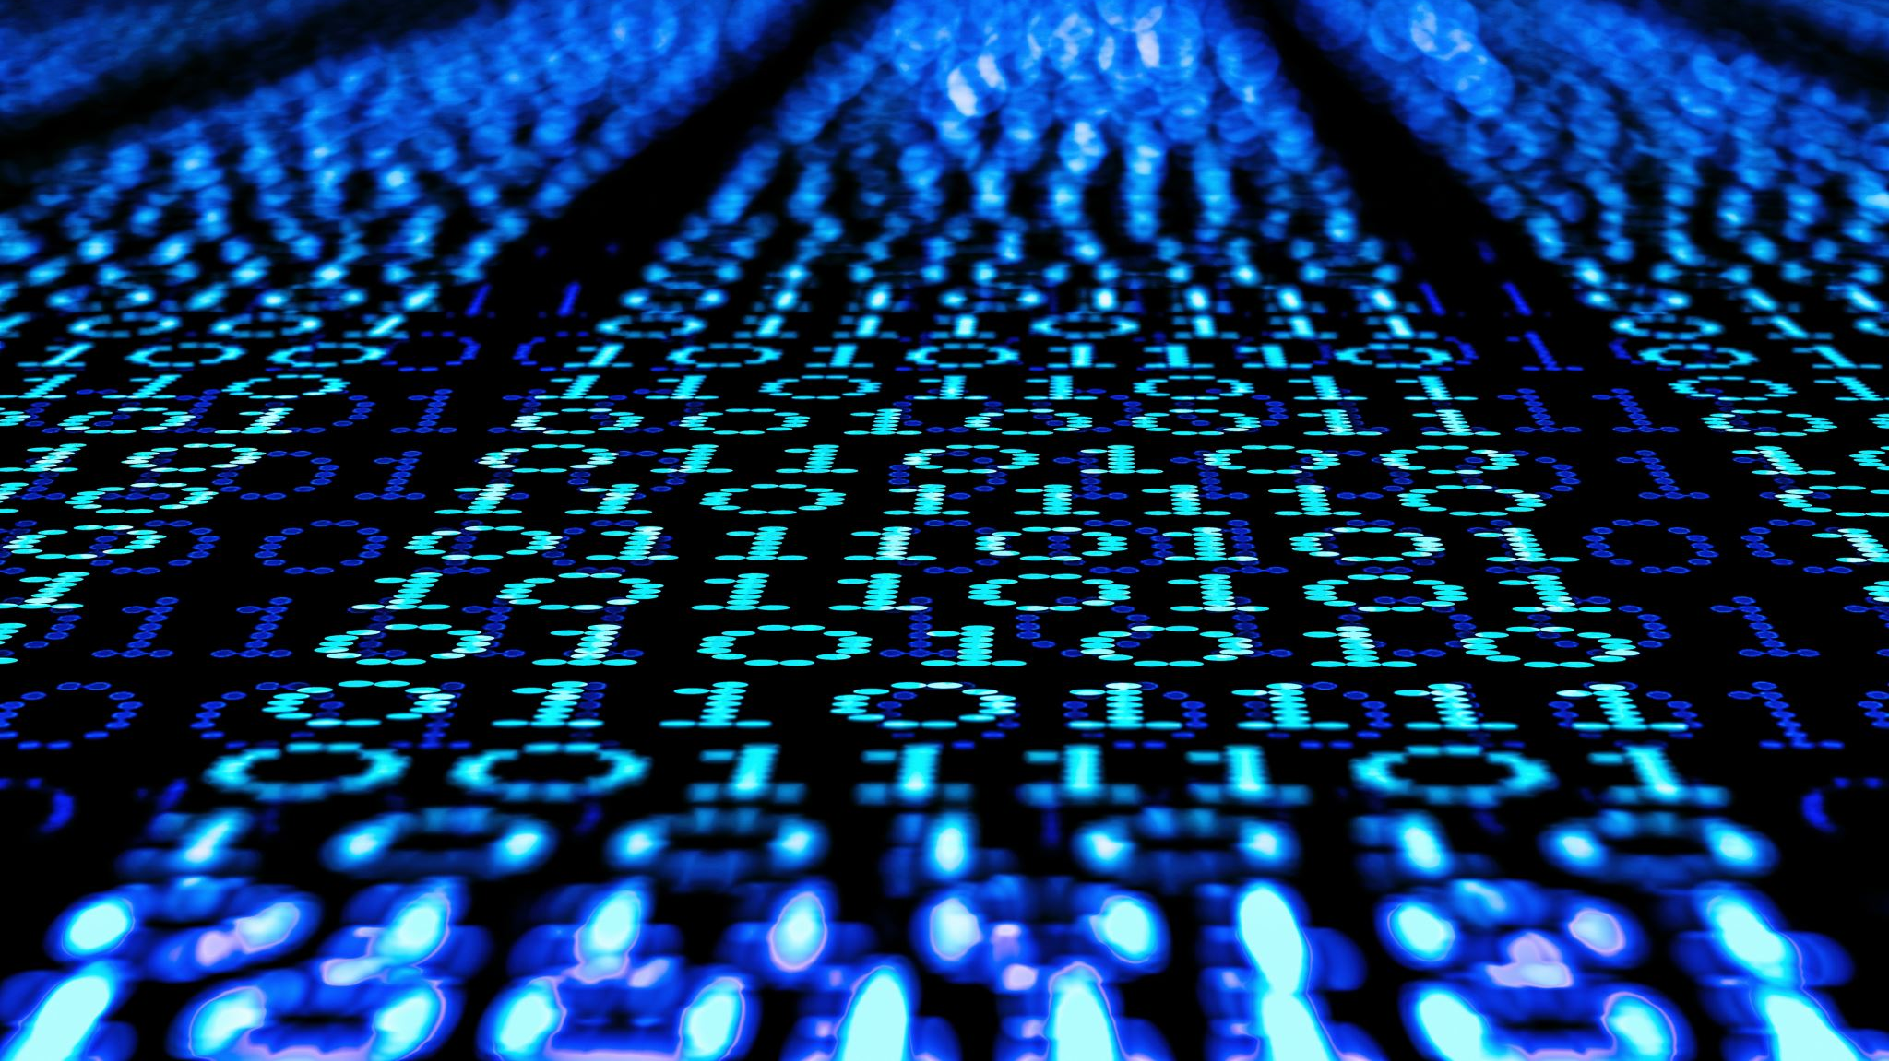
II. The matrix of being religious… A form of godliness, but denying its power???

Slide 19
III. The matrix of legalism GALATIANS 1,2,3

Slide 20
IV. The matrix of “family” patterns 1 Peter 1:18…..empty ways handed down to us

Slide 21
Freedom flows from CHOICE
BLESSINGS AND CURSES FLOW FROM OUR CHOICES…
LET US GO FORTH TODAY AND CHOOSE WISELY

