Slide 1
Notes:
the significance of Memorial Day, a time when we remember and honor those who made the ultimate sacrifice in military service.
Were willing to die, not many actually wanted to. Most people want to die of old age, in comfort surrounded by loved ones. Jesus got that, a few loved ones were there, but it was anything but comfortable. My father was a marine.

Slide 3
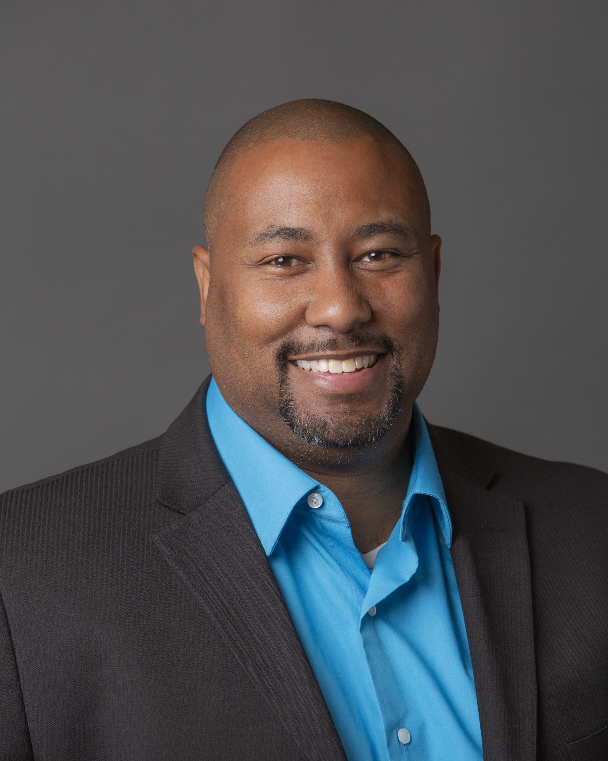
???????????????????????????????
=

Slide 4
When’s the last time you were (truly) afraid?
What were you afraid of and why?

Slide 6
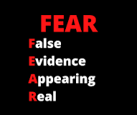
In situations where there's no true threat of immediate physical danger, no threat of a loss of someone or something dear to us, actually nothing there at all.
Notes:
Cowardice is when there’s no real danger. Danger is real

Slide 7
Psalm 23
The Lord is my shepherd; I shall not want.
² He maketh me to lie down in green pastures: he leadeth me beside the still waters.
³ He restoreth my soul: he leadeth me in the paths of righteousness for his name's sake.
⁴ Yea, though I walk through the valley of the shadow of death, I will fear no evil: for thou art with me; thy rod and thy staff they comfort me.
⁵ Thou preparest a table before me in the presence of mine enemies: thou anointest my head with oil; my cup runneth over.
⁶ Surely goodness and mercy shall follow me all the days of my life: and I will dwell in the house of the Lord for ever.

Slide 8
???????????????????????????????
=

Slide 9
SIN causes FEAR

Slide 10
So the Lord God called out to the man and said to him, “Where are you?” And he said, “I heard you in the garden, and I was afraid because I was naked, so I hid.”

Slide 11
Genesis 1:9-10
So the Lord God called out to the man and said to him, “Where are you?” And he said, “I heard you in the garden, and I was afraid because I was naked, so I hid.”
Notes:
Courageous Soldiers in the Lord's Army
- Highlight the parallels between military service and being a soldier in the Lord's army:
- Soldiers in the military are trained, disciplined, and dedicated to their cause.
- Similarly, as Christians, we are called to be courageous, devoted, and committed to the cause of Christ.
- Discuss how soldiers are willing to make sacrifices for their country and comrades. Relate this to how followers of Christ are called to sacrifice their own desires, serve others, and advance God's kingdom.
SONIC Dolls.

Slide 12
Luke 22
When a servant saw him sitting in the light, and looked closely at him, she said, “This man was with him too.” But he denied it: “Woman, I don’t know him.”
Notes:
Rules for thee, but not for me. Christian baptism before it was a thing.
The Ultimate Sacrifice of Christ
- Explore the concept of Jesus as the ultimate sacrifice:
- Jesus, the Son of God, willingly laid down His life on the cross for the redemption of humanity.
- His sacrifice brought reconciliation and peace between God and humanity.
- Connect the selflessness and sacrificial nature of military service to Jesus' sacrificial act on the cross.
- Reflect on the significance of Jesus' sacrifice and how it should inspire and motivate us in our own lives of service and sacrifice.

Slide 13
Judges 6
The angel of the Lord came, and he sat under the oak that was in Ophrah, which belonged to Joash, the Abiezrite. His son Gideon was threshing wheat in the winepress in order to hide it from the Midianites. Then the angel of the Lord appeared to him and said, “The Lord is with you, valiant warrior.”

Slide 14
When’s the last time you were (truly) afraid?
What were you afraid of and why?

