Slide 1
Notes:
WITH: for, under, over, from

Slide 2
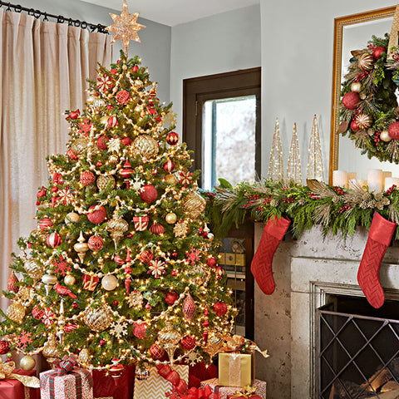

Slide 3
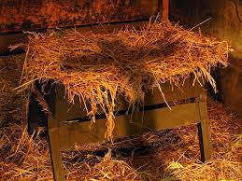

Slide 5
Which Christmas tree are you most focused on?
A. Christmas tree in your home
B. Christmas tree of the manger
C. Christmas tree of the cross

