Slide 2
HARMONY
MEN
WOMEN
GENERATIONS
RACES
Notes:
Instead of battle of the sexes, balance of the sexes.

Slide 3
One body, many parts
1 Corinthians 12:12-27

Slide 4
Father, Son, & Holy Spirit
Then God said, “Let us make man in our image, according to our likeness...”
So God created man in his own image; he created him in the image of God; he created them male and female. - Genesis 1:26-27

Slide 6
Matthew 27:22-26
Pilate asked them, “What should I do then with Jesus, who is called Christ?” They all answered, “Crucify him!” Then he said, “Why? What has he done wrong?” But they kept shouting all the more, “Crucify him!”
When Pilate saw that he was getting nowhere, but that a riot was starting instead, he took some water, washed his hands in front of the crowd, and said, “I am innocent of this man’s blood. See to it yourselves!”
All the people answered, “His blood be on us and on our children!” Then he released Barabbas to them and, after having Jesus flogged, handed him over to be crucified.

Slide 7
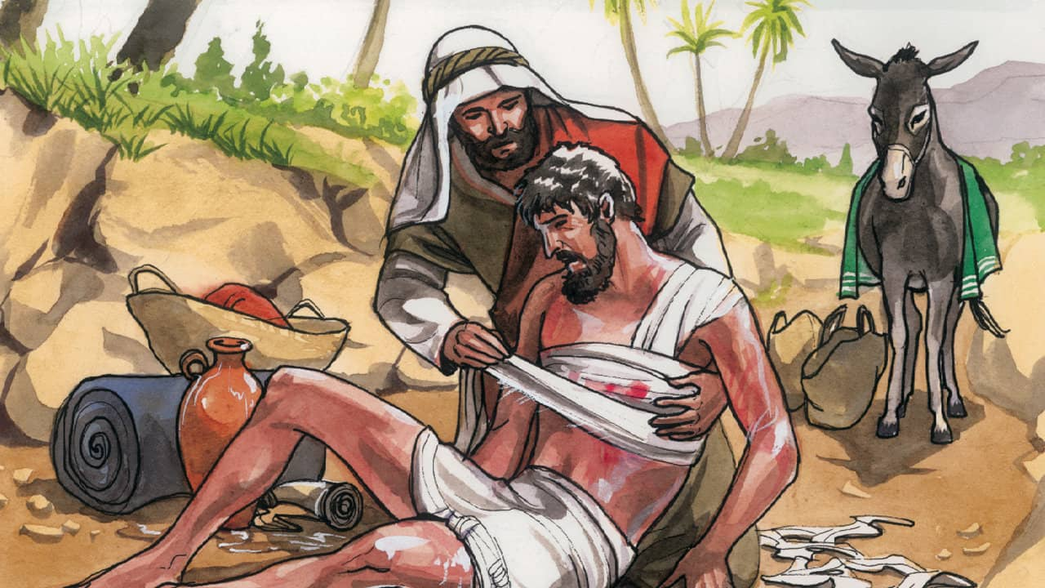
The good samaritan
Luke 10:25-37

Slide 8
Questions for reflection & connection groups
Is there some sin that is growing in secret in your life?
1
Is there something that is impeding harmony that you should speak up about?
2
What can you do to promote greater racial harmony both in the church and outside of it?
3

