Slide 2
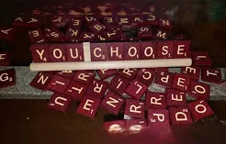

Slide 4
Harmony in our lives
1Corinthians 12:12-18

Slide 5
Harmony in our lives
Genesis 13

Slide 6
Harmony in our lives
john 12:44-50

Slide 7
Harmony in our lives
What really knocks me out is a book that, when you're all done reading it, you wish the author that wrote it was a terrific friend of yours and you could call him up on the phone whenever you felt like it. That doesn't happen much, though.
- Holden Caulfield, “The Catcher in the Rye”

Slide 8
Harmony in our lives
Philippians 3:1-11

Slide 9
Questions for reflection & connection groups
How submitted are you to God’s will for your life?
1
Is “Jesus is Lord” the lens through which you make all decisions?
2
How well do you know the book (Bible), and how well do you know the author (God)?
3

