Slide 3
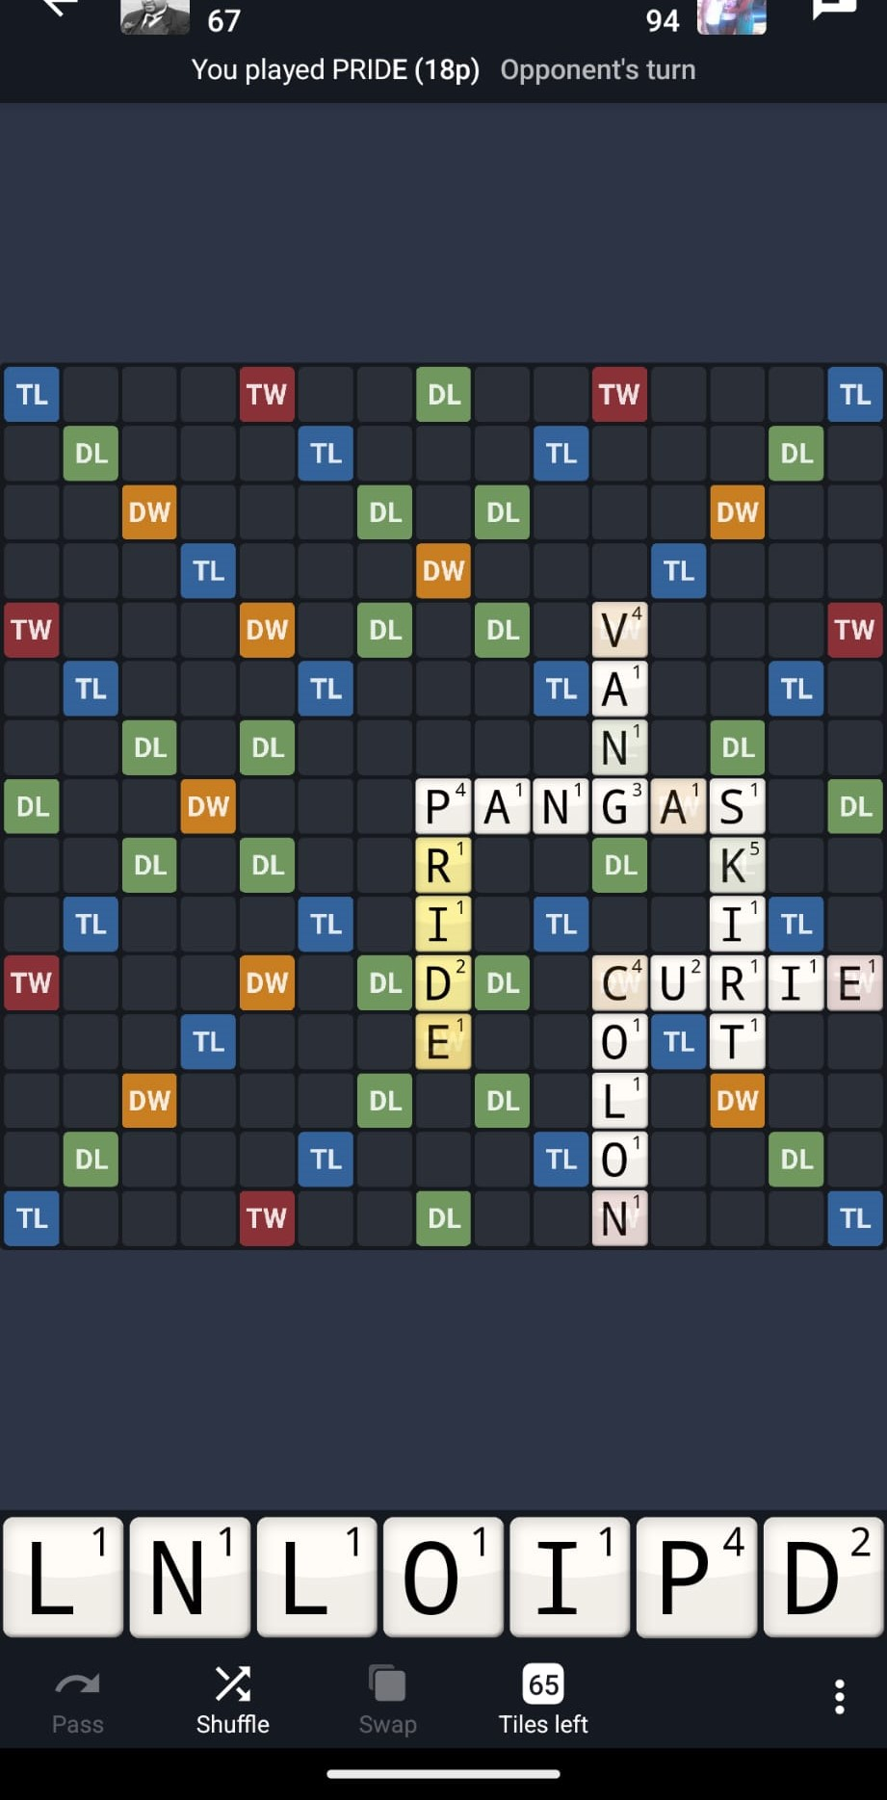

Slide 4
Harmony in our lives
In my futile life I have seen everything: someone righteous perishes in spite of his righteousness, and someone wicked lives long in spite of his evil. Don’t be excessively righteous, and don’t be overly wise. Why should you destroy yourself? Don’t be excessively wicked, and don’t be foolish. Why should you die before your time? It is good that you grasp the one and do not let the other slip from your hand. For the one who fears God will end up with both of them. - Ecclesiastes 7:15-18

Slide 5
Harmony in our lives
Ecclesiastes 3:1-14

Slide 6
Harmony in our lives
Luke 10:38-42

Slide 7
Harmony in our lives
Luke 11:37-42

Slide 8
Questions for reflection & connection groups
What is it a “time for” in your life right now?
1
Do you avoid all extremes? If not, why not? How can you overcome this?
2
How do you balance being in the world but not of the world?
3

