Slide 1
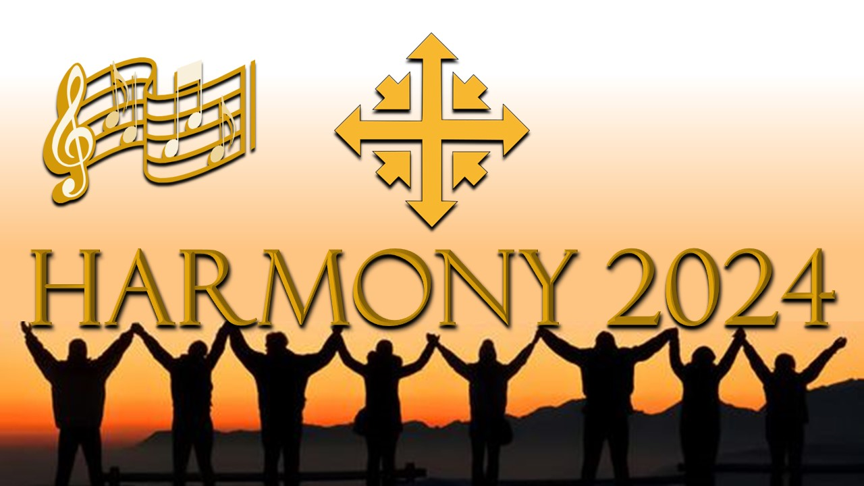

Slide 2
Resurrection Sunday
What has been the most important day in your life?

Slide 3
Harmony in our lives
Matthew 27

Slide 4
2 Peter 3:8-9
Dear friends, don’t overlook this one fact: With the Lord one day is like a thousand years, and a thousand years like one day. The Lord does not delay his promise, as some understand delay, but is patient with you, not wanting any to perish but all to come to repentance.

Slide 5
Resurrection sunday
Acts 2:32-41

Slide 6
Resurrection Sunday
How will you respond to the most important day in Jesus’ life?

