Slide 1
Love and Judgement
Hamilton Von Wiegand, MA, LPC, CPCS

Slide 2
The Path Ahead
1. The purpose of creation is to display and participate in the glorious love of the triune God.
2. Something went wrong and now we judge instead of loving.
3. How the Gospel remedies this.
*Disclaimer – Just because I reference or quote an author does not mean I fully endorse all of their opinions or ides.

Slide 3
The Purpose of Creation - Glory & Love, Love & Glory
The Universe is a cosmic temple to display the glory of God:
Psalm 19:1 “The heavens declare the glory of God, and the sky above proclaims his handiwork.” Isaiah 66:1 “Thus says the Lord: “Heaven is my throne, and the earth is my footstool; what is the house that you would build for me, and what is the place of my rest?”
Romans 1:20–23 “For his invisible attributes, namely, his eternal power and divine nature, have been clearly perceived, ever since the creation of the world, in the things that have been made. So they are without excuse. For although they knew God, they did not honor him as God or give thanks to him, but they became futile in their thinking, and their foolish hearts were darkened. Claiming to be wise, they became fools, and exchanged the glory of the immortal God for images resembling mortal man and birds and animals and creeping things.”
Gen 1:1-31 - The creation in 7 days.

Slide 4
Further study on the purpose of creation as glory
Psalm 148 — all creation is summoned to praise its Maker.
Isaiah 43:6–7 — God created his people “for my glory.”
Romans 11:36 — “from him… through him… to him are all things.” -> towards his glorification Habakkuk 2:14 - all of the world will bill filled with the knowledge of God’s glory
Isaiah 11:6-9 - Eschatalogical end of violence linked with knowledge of the Lord

Slide 5

What is God’s Glory?

Slide 6
Moses said, “Please show me your glory.” And he said, “I will make all my goodness pass before you and will proclaim before you my name ‘The Lord.’ And I will be gracious to whom I will be gracious, and will show mercy on whom I will show mercy. But,” he said, “you cannot see my face, for man shall not see me and live.” And the Lord said, “Behold, there is a place by me where you shall stand on the rock, and while my glory passes by I will put you in a cleft of the rock, and I will cover you with my hand until I have passed by. Then I will take away my hand, and you shall see my back, but my face shall not be seen.” The Lord said to Moses, “Cut for yourself two tablets of stone like the first, and I will write on the tablets the words that were on the first tablets, which you broke. Be ready by the morning, and come up in the morning to Mount Sinai, and present yourself there to me on the top of the mountain. No one shall come up with you, and let no one be seen throughout all the mountain. Let no flocks or herds graze opposite that mountain.” So Moses cut two tablets of stone like the first. And he rose early in the morning and went up on Mount Sinai, as the Lord had commanded him, and took in his hand two tablets of stone. The Lord descended in the cloud and stood with him there, and proclaimed the name of the Lord. The Lord passed before him and proclaimed, “The Lord, the Lord, a God merciful and gracious, slow to anger, and abounding in steadfast love and faithfulness, keeping steadfast love for thousands, forgiving iniquity and transgression and sin, but who will by no means clear the guilty, visiting the iniquity of the fathers on the children and the children’s children, to the third and the fourth generation.” And Moses quickly bowed his head toward the earth and worshiped. And he said, “If now I have found favor in your sight, O Lord, please let the Lord go in the midst of us, for it is a stiff-necked people, and pardon our iniquity and our sin, and take us for your inheritance.”
Exodus 33:18–34:9

Slide 7
The Purpose of Creation is Love
Ps 57:9-11 God’s glory is linked with his steadfast love
Ps 108:3-4 - God is praised for his steadfast love
Ps 115:1 - glory given to God because of his steadfast love
1 John 4:8 - God is love.
2 Peter 1:4 - God, through/in Jesus, enables us to share in His divine nature.
Ezek. 18:23, 32; 33:11, 2 Peter 3:9, 1 Timothy 2:4 - God desires that all would repent and turn to him.
The purpose of creation is thus to reveal/display the Glory of God, which is primarily that of love and to participate in that glorious love.

Slide 8
“I do not ask for these only, but also for those who will believe in me through their word, that they may all be one, just as you, Father, are in me, and I in you, that they also may be in us, so that the world may believe that you have sent me. The glory that you have given me I have given to them, that they may be one even as we are one, I in them and you in me, that they may become perfectly one, so that the world may know that you sent me and loved them even as you loved me. Father, I desire that they also, whom you have given me, may be with me where I am, to see my glory that you have given me because you loved me before the foundation of the world. O righteous Father, even though the world does not know you, I know you, and these know that you have sent me. I made known to them your name, and I will continue to make it known, that the love with which you have loved me may be in them, and I in them.”
John 17:20–26

Slide 9
Further Study on the purpose of creation being the display and participation in God’s Love:
Isaiah 11:9 - end of violence is tied with the knowledge of the Lord filling the world
Eph 1:3-10 God’s plan has always been to adopt a people and unite all things in Christ
Eph 2:5-7 raised us and seated us with Christ (throne imagery) to show his grace and kindness
Eph 2:19-22 all believers members of God’s family and part of a living temple in Christ
Col 1:15-20 in Christ, God is reconciling all things to Himself Rom
8:18-23 all of creation is awaiting redemption that is tied to the full adoption of God’s redeemed people.
1 John 3:16, 4:8,16,20 - God’s essence is love, demonstrated in Jesus the Christ, and we are called to the same.
Col 1:15, Heb 1:3 - Jesus is the image and exact imprint of the invisible God, displaying the radiance of his glory
Rev 21:1-4, 9-16, 22-26 - the New Heaven, New Earth, and New Jerusalem where God dwells with his people (temple)

Slide 10
What went wrong?
Genesis 1:26-28, 2:15-17, 3:6-7

Slide 11
Genesis 1:26-28
Then God said, “Let us make man in our image, after our likeness. And let them have dominion over the fish of the sea and over the birds of the heavens and over the livestock and over all the earth and over every creeping thing that creeps on the earth.” So God created man in his own image, in the image of God he created him; male and female he created them. And God blessed them. And God said to them, “Be fruitful and multiply and fill the earth and subdue it, and have dominion over the fish of the sea and over the birds of the heavens and over every living thing that moves on the earth.”

Slide 12
Genesis 2:15-27
The Lord God took the man and put him in the garden of Eden to work it and keep it. And the Lord God commanded the man, saying, “You may surely eat of every tree of the garden, but of the tree of the knowledge of good and evil you shall not eat, for in the day that you eat of it you shall surely die.”

Slide 13
Genesis 3:6-7
So when the woman saw that the tree was good for food, and that it was a delight to the eyes, and that the tree was to be desired to make one wise, she took of its fruit and ate, and she also gave some to her husband who was with her, and he ate. Then the eyes of both were opened, and they knew that they were naked. And they sewed fig leaves together and made themselves loincloths.

Slide 14

Transgression of Divine Boundary
“The people’s sin is pride and disrespect for God’s authority, seeking to obtain that which was forbidden—wisdom that would make them like God.” (Mangum)
Knowledge to decide what is in their own best interests, to judge what is good/bad.

Slide 15
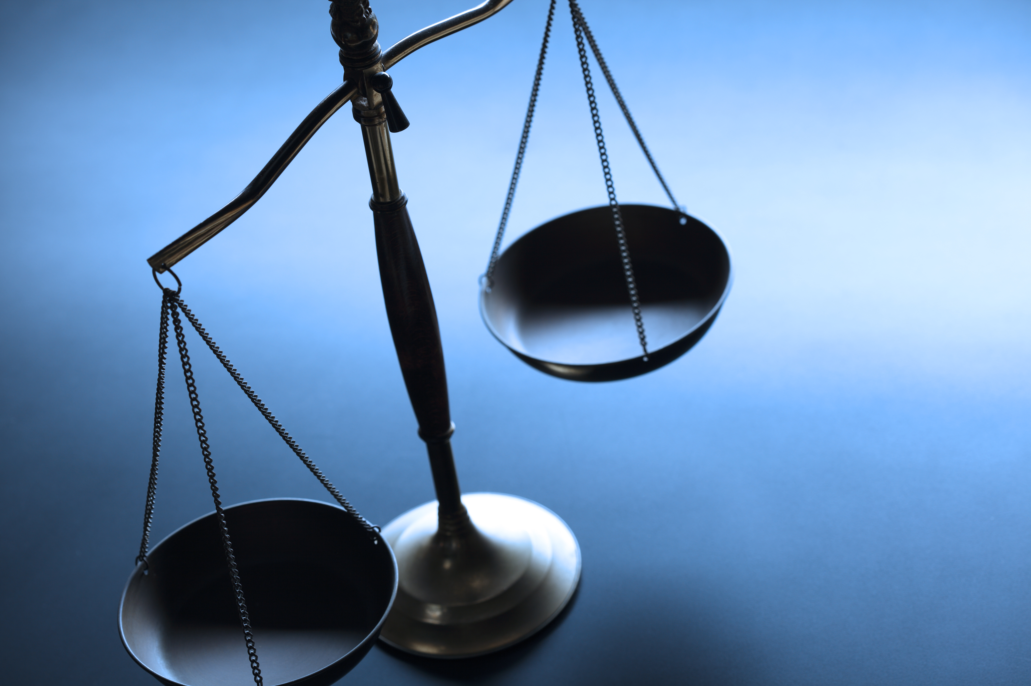
The Knowledge of Good and Evil
If the tree of knowledge of Good & evil is about judging what's good evil and Eve took the fruit because she wanted to be like God, then it makes plausible sense that-part of our fallen nature is the urge to judge without the omniscience and omnibenevolence to do so.

Slide 16
It is God’s Place and Prerogative to Judge
Ecclesiastes 12:14 “For God will bring every deed into judgment, with every secret thing, whether good or evil.”
Ps 89:14 “Righteousness and justice are the foundation of your throne; steadfast love and faithfulness go before you.”
Psalm 96:10 “Say among the nations, “The Lord reigns! Yes, the world is established; it shall never be moved; he will judge the peoples with equity.”
Further Study on God as Worthy Judge: Ps 96:10,13 ;Psalm 97:2; Isa 11:4-5; 1 Sam 16:7; Eccles 12:14; 1 Cor 4:5; 1 Peter 1:17

Slide 17
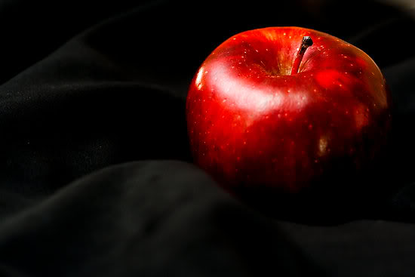
Transgressing all over again
When we judge improperly we are eating of the forbidden fruit once again.
This Photo by Unknown Author is licensed under CC BY-NC-ND

Slide 18
The Dangers of Judgement: Self-Righteousness and the CAD Triad
”For God shows no partiality.” Romans 2:11

Slide 19
Self-Righteous Judgement
Luke 18:9-14 - “He also told this parable to some who trusted in themselves that they were righteous, and treated others with contempt”
Mat 7:1-5 - Judging others leads to hypocritical self-righteousness

Slide 20
Judgement and the CAD Triad
When we are self-righteous in our judgement, the CAD Triad is not far off
Contempt - triggered especially by purity/sanctity violations (sexual, religious, “contamination” themes); action tendency = avoid, expel, “cleanse.”
Anger - triggered by perceived harm, injustice, or rights violations; action tendency = confront, punish, correct.
Disgust - triggered by perceived inferiority, norm unworthiness, or low moral character; action tendency = exclude, distance, downgrade status.
These emotional experiences have an amplifying affect on judgement and self-righteousness, leading to a self-strengthening feedback loop.

Slide 21
Anger & Judgement
Matthew 5:21-24 - Anger as Judgement—>leading to insults and judging someone as “you fool” (raca) - good for nothing idiot.
Anger→Resentment→Contempt
Matthew 5:22 “But I say to you that everyone who is angry with his brother will be liable to judgment; whoever insults his brother will be liable to the council; and whoever says, ‘You fool!’ will be liable to the hell of fire.”
Hell = Gehenna, Valley of Hinnom, associated with child sacrifice in the ancient world and a smoldering garbage dump during NT times

Slide 22
Further Study
Mat 5:27-30 Lust as judgement - this person is desirable, I want them, until no longer satisfying and arousing, then discard.
Matthew 5:31-32 Divorce as judgement - you are no longer good for me, no longer desirable, so discard.

Slide 23
“Every time you decide to let your anger smoulder on inside you, you are becoming a little less than fully human. You are deciding to belittle yourself…And if you are the sort of person who sneers at everybody and calls them names, the fire inside you may eventually become all that’s left of you, as Gehenna–the smouldering garbage dump of ancient Jerusalem – may take you over completely.” (WRIGHT, 2023)

Slide 24
How the Gospel teaches and empowers us to stop judging

Slide 25

What is the problem that the Gospel is fixing?
It’s not just…
Guilt
or judgement
or justice
or wrath
that the gospel is addressing.

Slide 26
The Gospel = Jesus is Christ/King, In Him…
The kingdom/reign of God/Heaven has come and is being restored (Mt 4:17, Mk 1:14-15, Acts 3:18-20, 17:2-3, 5:42, 8:12, 19:8, 28:31)
Sin and death are being rendered impotent (Acts 2:24, 1 Cor 15:26,54-57, Heb 2:14-15, Rom 8:2, Eph 1:19-23, 2 Tim 1:10, 1 Jn 3:8, Rev 1:18)
Genuine humanity as full image bearers is restored and made available (Gen 1:26-28, Col 1:15, Heb 1:3, 1 Cor 15:49, 2 Cor 3:17-18, Col 3:10, Rm 8:29-30)
The purpose of all creation (the display and participation in God’s glory-love) is being restored (Rom 8:18-23, Rev 21:1-7, 22:4).

Slide 27
Our response to the Gospel…
“Jesus is Lord,” (Acts 2:36-41) and
Then embody that allegiance in how we live and treat others (Mt 4:19, 16:24, Lk 9:23, Lk 18:22, Jn 12:26, 13:34-35, 14:15-24).
Which we all know is summed up in the greatest commands. Matthew 22:34-40 - The greatest commands are to love God and others.
Matthew 5:43-48 Love even those who seek/desire to harm you.
John 15:13 True love is self-giving and self-sacrificial.
Romans 5:6-10, 1 John 4:7-11 God demonstrated his Love for us by sending Jesus and we are called to love others in the same fashion.

Slide 28
For the disciple of Christ, there is no other, no enemy. Every man is a potential lost brother, uncle, father. Every woman is lost sister, aunt, mother. All the world is invited into our family and a place at the table. To hesed/agape love is to see the other as having unsurpassable worth.

Slide 29
Letting go of Judgement, Picking up Love
Jesus does not call us primarily to judge others, but to love them by viewing and treating them as having unsurpassable worth.
What can help with this?
Regularly behold the glory of God displayed in Christ
Practice the presence of God as you go more and more
Any time you are tempted to judge, stop and first remind yourself that God has deemed that person as having unsurpassable worth
Make it a habit of praying as you go (everywhere) for God to bless the people you see and are around.

Slide 30
References
Bates, M. W. (2023). Why the gospel?: Living the good news of king jesus with purpose. William B. Eerdmans Publishing Company.
Boyd, Gregory A. 2004. Repenting of Religion: Turning from Judgment to the Love of God. Grand Rapids, MI: Baker.
Keener, C. S., & Walton, J. H. (2017). NKJV, Cultural Backgrounds Study Bible. Zondervan.
P. Kreeft, (1988). Knowing the Truth about God’s Love: The One Thing We Can’t Live Without. Ann Arbor, Mich.: Servant.
Mangum, Douglas, ed. 2020. Lexham Context Commentary: New Testament. Lexham Context Commentary. Bellingham, WA: Lexham Press.
WRIGHT, N. T. (2023). Matthew for everyone: Chapters 1-15. WESTMINSTER JOHN KNOX.

