Slide 1
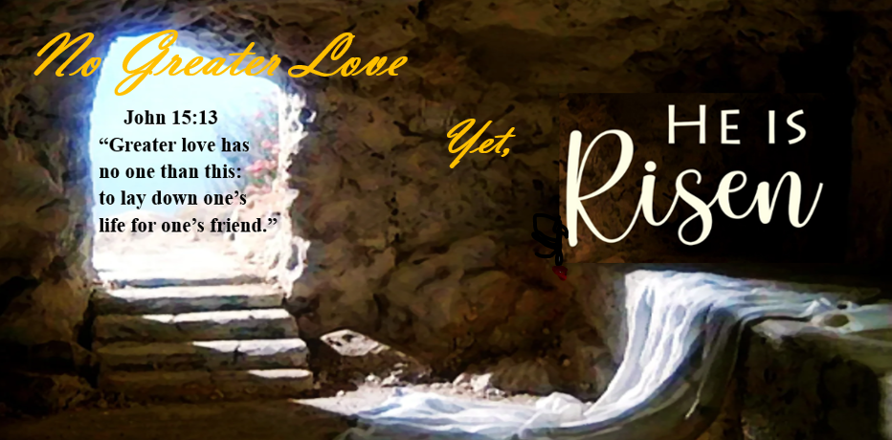

Slide 2
Ephesians 1:18-21
Reticular
Activator

Slide 3
Genesis 3:1-7 – The problem
No! You will certainly not die,” the serpent said to the woman. “In fact, God knows that when you eat it your eyes will be opened and you will be like God, knowing good and evil.”

Slide 4
Genesis 1:26-27 – the reality
Then God said, “Let us make man in our image, according to our likeness. They will rule the fish of the sea, the birds of the sky, the livestock, the whole earth, and the creatures that crawl on the earth.” So God created man in his own image; he created him in the image of God; he created them male and female.

Slide 5
Death – The solution
Luke 23:32-49

Slide 6
Burial – The solution
Luke 23:50-56

Slide 7
Resurrection – The solution
Luke 24:1-12

Slide 8
Questions for reflection
Am I looking at my life with wordly eyes or spiritual eyes?
What things in my life or character that need to be put to death and buried?
Am I looking for the living among the dead?

